Slide 1
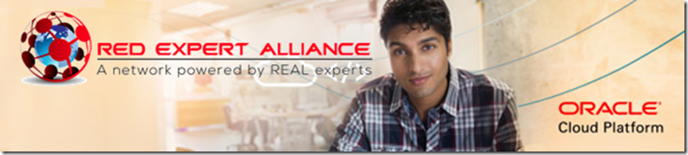

Six Virtual Developer Meetups
Wednesday June 10th – Kick Off
http://bit.ly/real-oci
Cloud Native Application Development on Oracle Cloud Platform
Overview OCI | Preparation for Hands On Scenarios | Object Storage | Compute | Events | Notifications

Slide 2
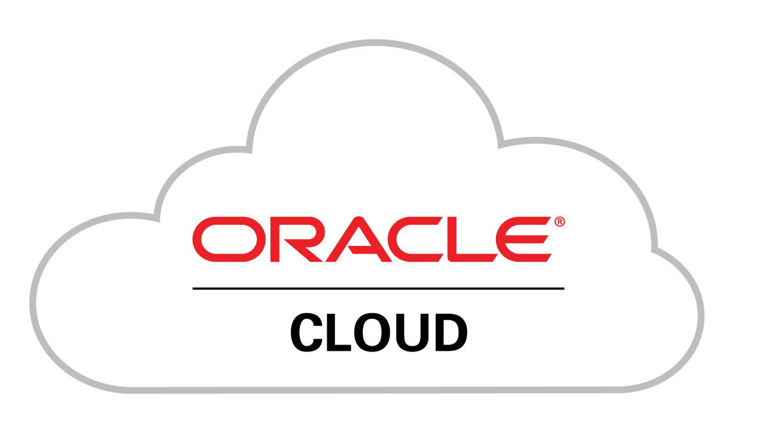

See
Hear
Native Application Development
Do

Slide 3

Touring Oracle Cloud services for cloud native application development
Introduction
Demonstration
Guided Handson Labs
Q&A
All sessions are recorded and will be available for replay

Slide 4


Slide 5
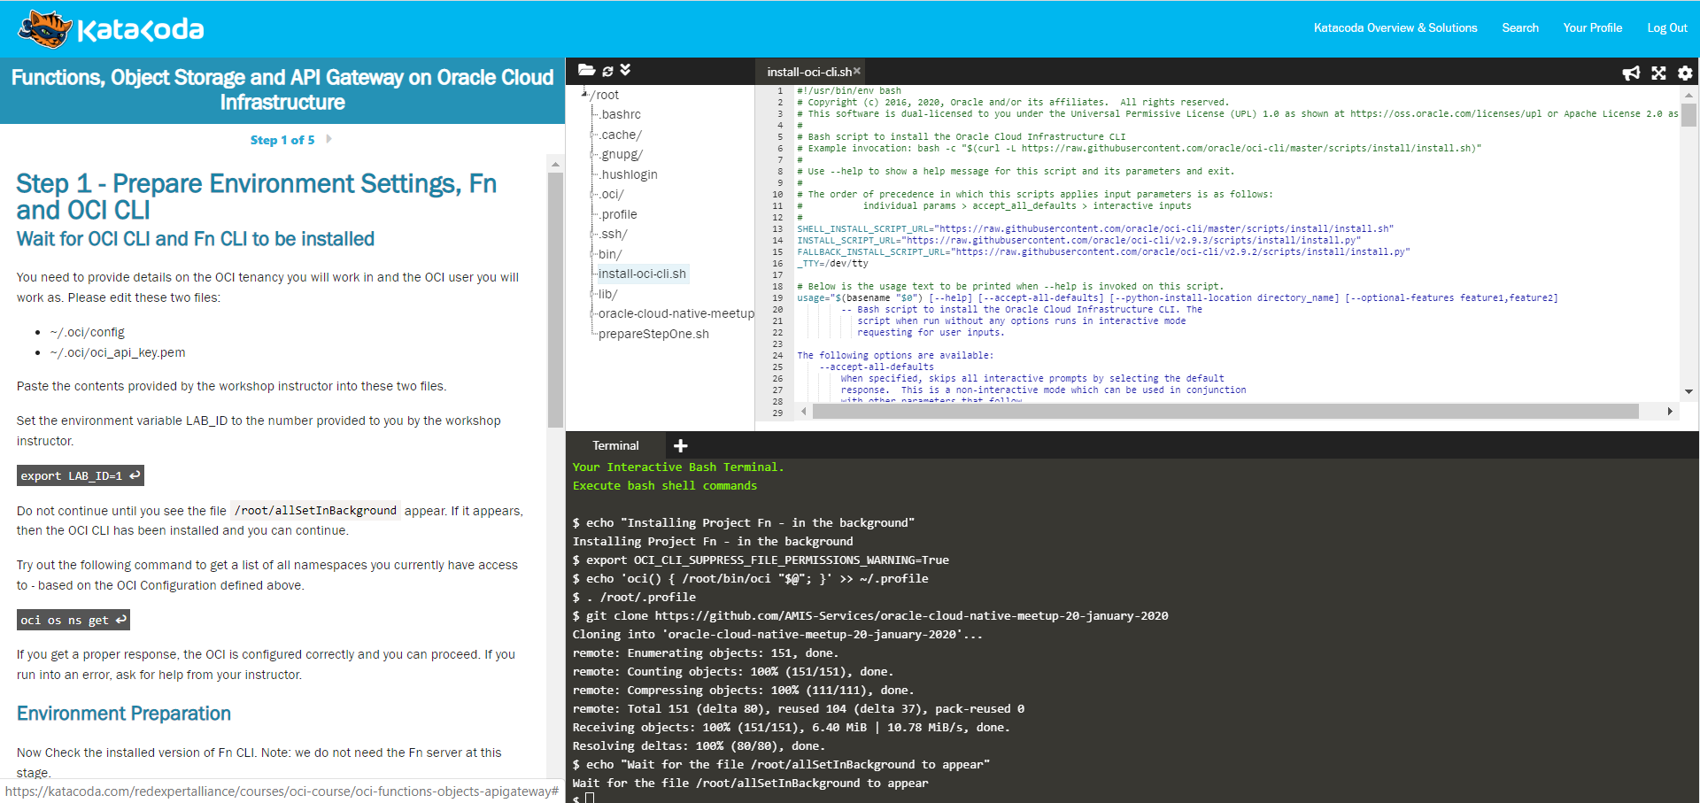
Step by Step instructions and <code snippets>
Text Editor
File Explorer on Scenario Resources
One or more terminal windows on Linux VMs with OCI CLI, Fn, Node, JDK, Docker, …

Slide 6
A scenario environment lives for 60 minutes
After that: it is killed and removed
You can run a scenario multiple times
Feel free to share links to the scenarios with friends and family
The scenario definitions and all sources live on GitHub
You are welcome to use code snippets and to submit Pull Requests with suggestions and improvements
GitHub Repo URL: github.com/RedExpertAlliance/katacoda-scenarios/tree/master/oci-course
We keep improving and adding scenarios – so check back now and again
http://bit.ly/real-oci

Slide 7

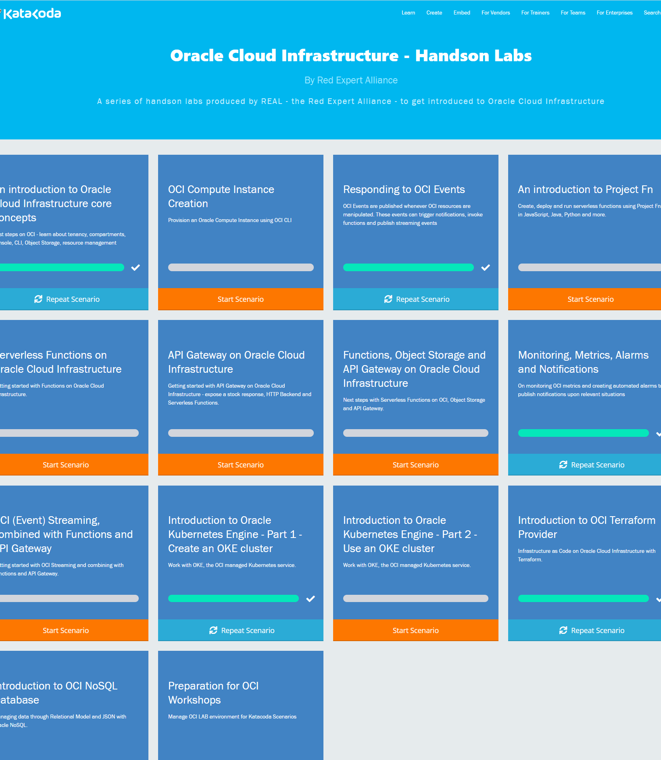
The REAL OCI handson scenarios on Katacoda
http://bit.ly/real-oci

Slide 8
What is Cloud Native?
Born in Cloud
No explicit Infrastructure (serverless) & Fully Managed Platform components
Quick Ramp Up
Scalable/Elastic
Pay per Use
Automation
Infrastructure/Platform as Code (automation)
Automated CI/CD [pipelines]

Slide 9

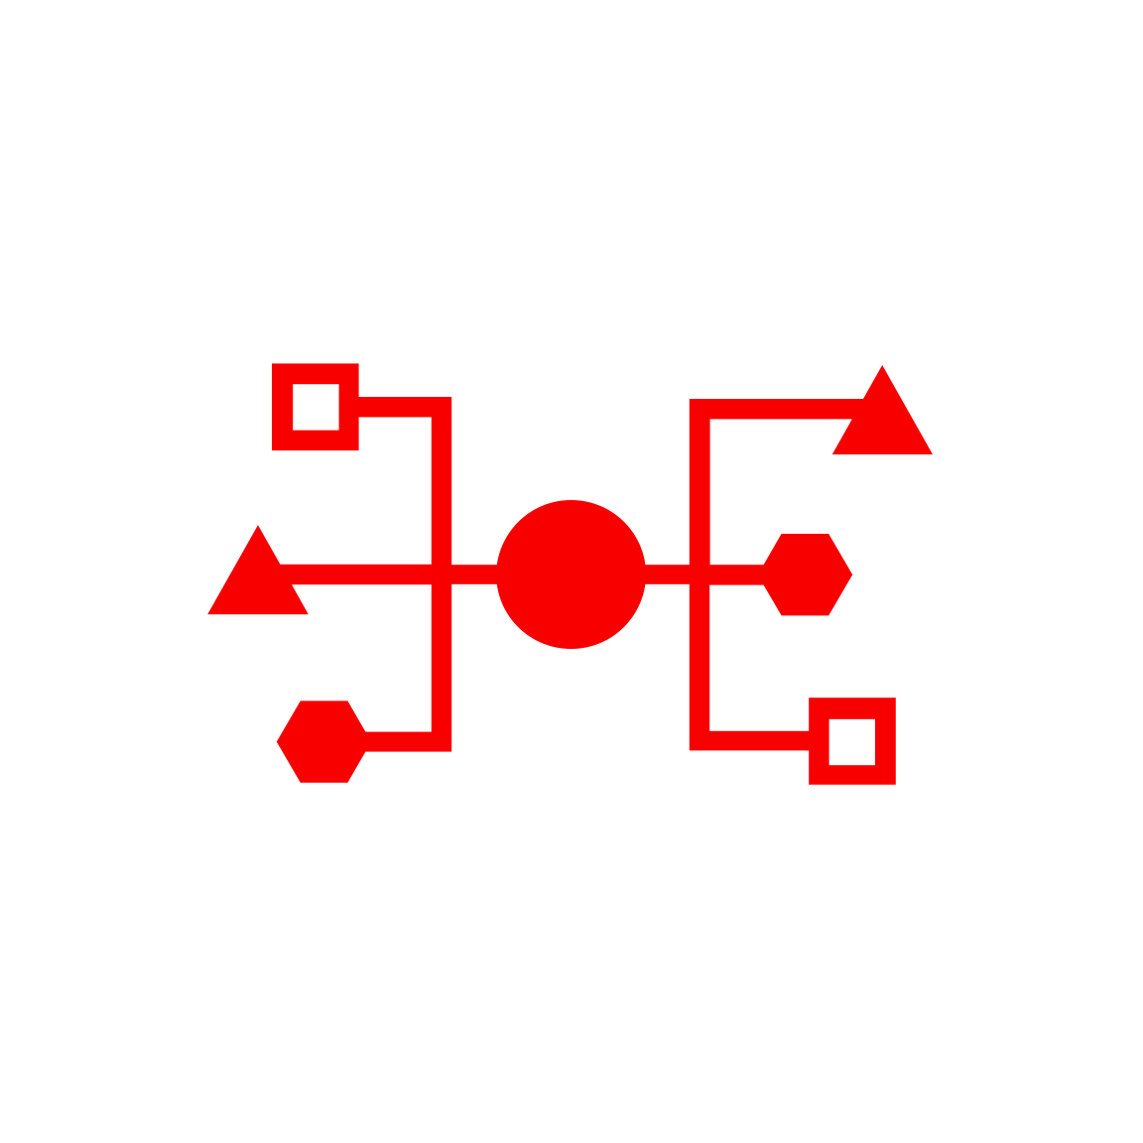


Health Check
Monitoring
Logging
Alarms
Notifi-cations
OCI Services for Cloud Native Application Development
API Gateway
Functions
Streaming
Digital Assistant
NoSQL Database
Object Storage
OKE – Managed Kubernetes
Container
Container
OCIR
ID & Access
Management
Tagging
Compartments
API/Service
Events
Resource
Manager
Search
Compute

Slide 10
Health Check
Monitoring
Logging
Alarms
Notifi-cations
API Gateway
Functions
Streaming
Digital Assistant
NoSQL Database
Object Storage
OKE – Managed Kubernetes
Container
Container
OCIR
ID & Access
Management
Tagging
Compartments
API/Service
Events
Resource
Manager
Search
Compute

Slide 11
Health Check
Monitoring
Logging
Alarms
Notifi-cations
API Gateway
Functions
Streaming
OKE – Managed Kubernetes
Container
Digital Assistant
Container
NoSQL Database
OCIR
Object Storage
Compute
ID & Access
Management
Tagging
Compartments
API/Service
Events
Resource
Manager
Search

Slide 12
Health Check
Monitoring
Logging
Alarms
Notifi-cations
API Gateway
Functions
Streaming
OKE – Managed Kubernetes
Container
Digital Assistant
Container
NoSQL Database
OCIR
Object Storage
Compute
ID & Access
Management
Tagging
Compartments
API/Service
Events
Resource
Manager
Search

Slide 13
Health Check
Monitoring
Logging
Alarms
Notifi-cations
API Gateway
Functions
Streaming
OKE – Managed Kubernetes
Container
Digital Assistant
Container
NoSQL Database
OCIR
Object Storage
Compute
ID & Access
Management
Tagging
Compartments
API/Service
Events
Resource
Manager
Search

Slide 14
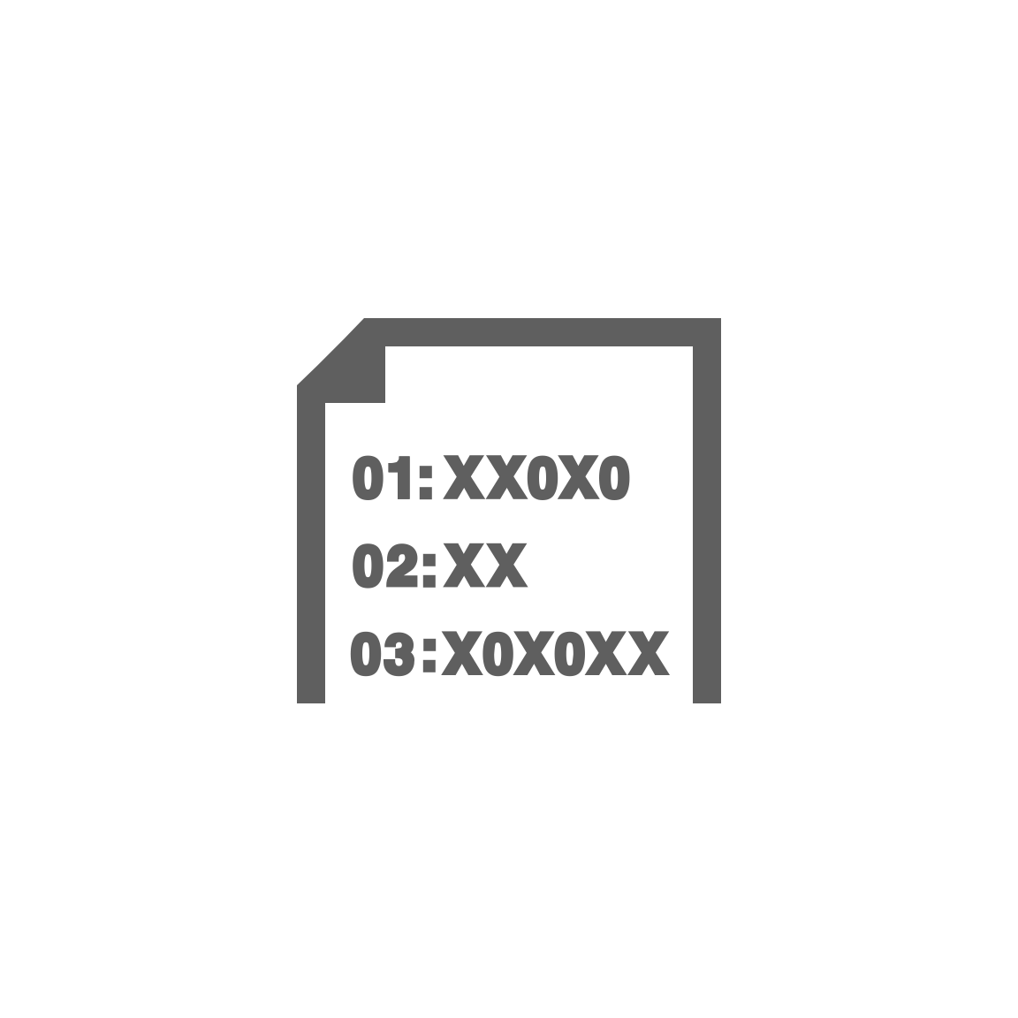


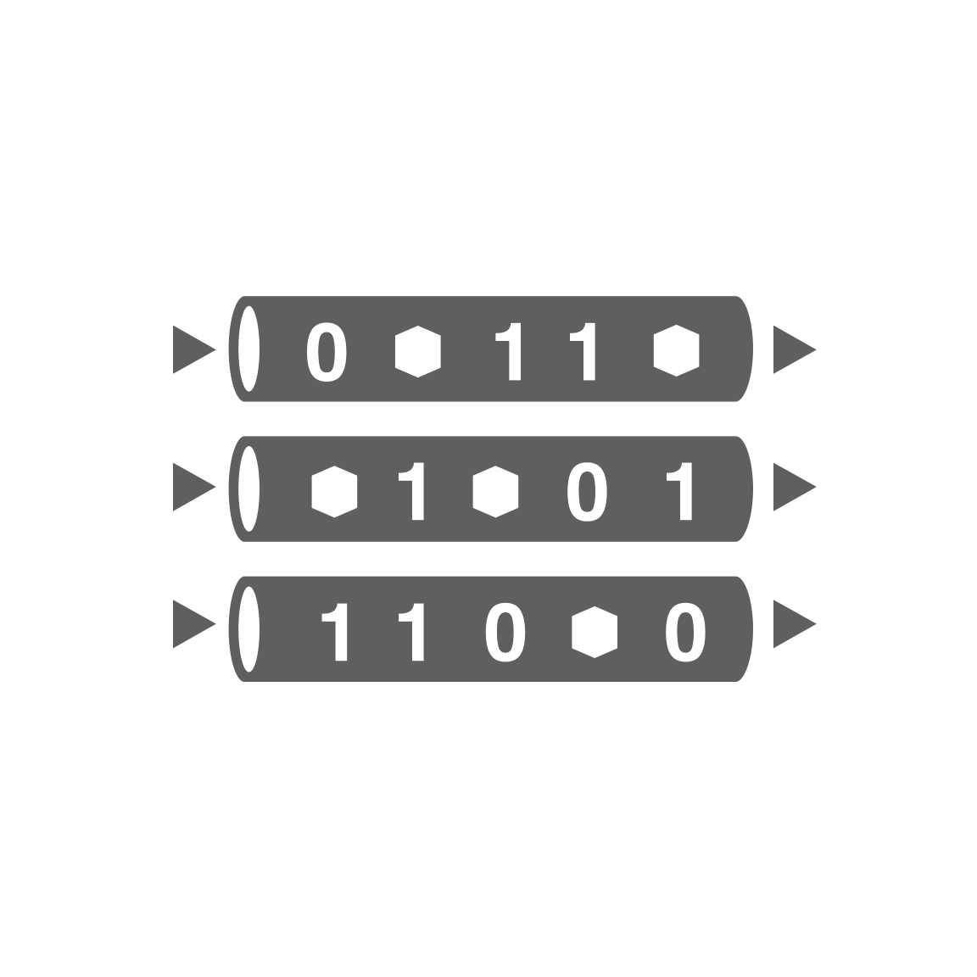
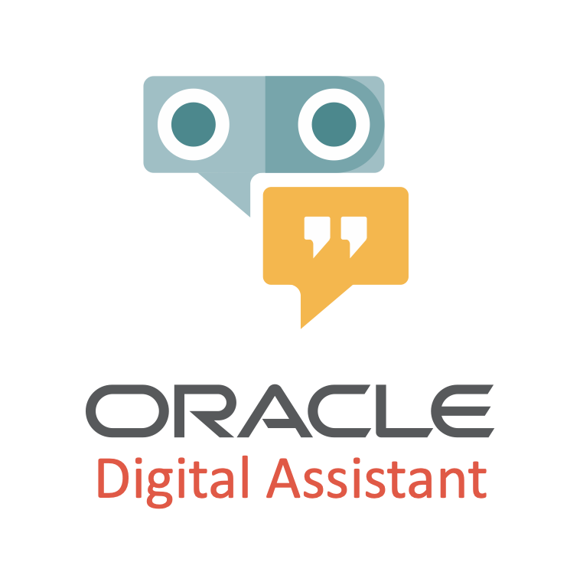
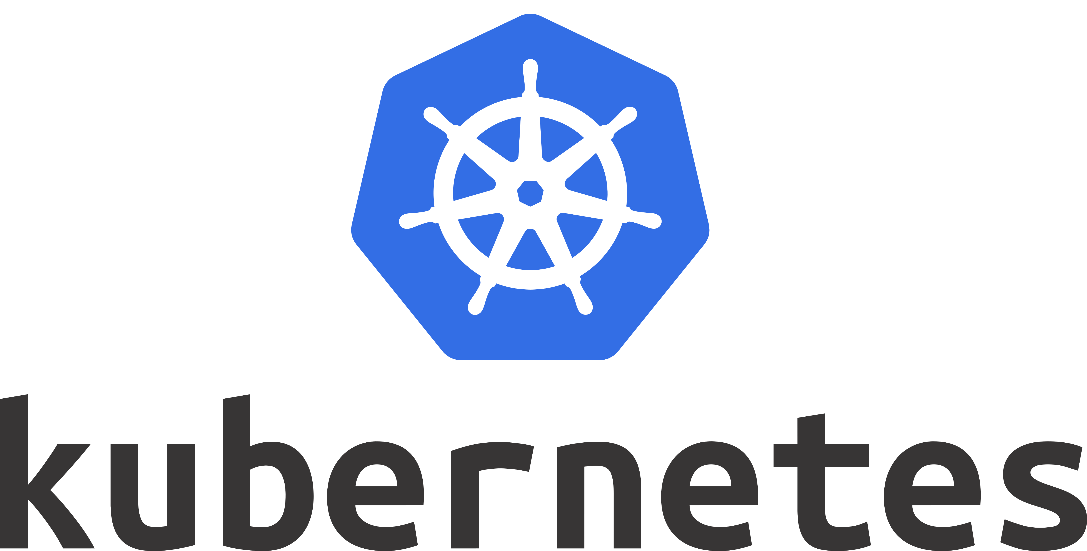
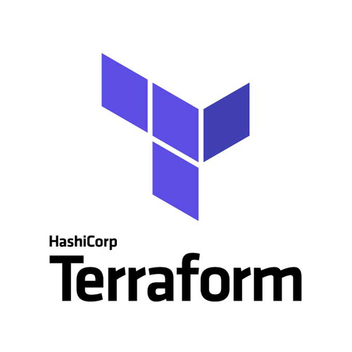
Health Check
Monitoring
Logging
Alarms
Notifi-cations
Healthcheck
Telemetry/ Monitoring
Logging
Alarming
Notifications
API Gateway
Functions
Streaming
OKE – Managed Kubernetes
Container
Streaming
Digital Assistant
Container
NoSQL Database
Container
OCIR
Container
Object Storage
Compute
Object Storage
Virtual Machine
ID & Access
Management
Tagging
Compartments
API/Service
Events
Resource
Manager
Search

Slide 15












Slide 17
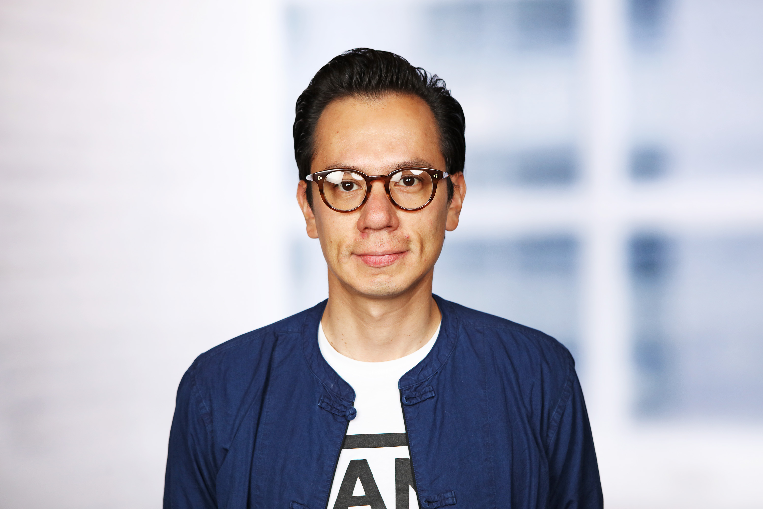


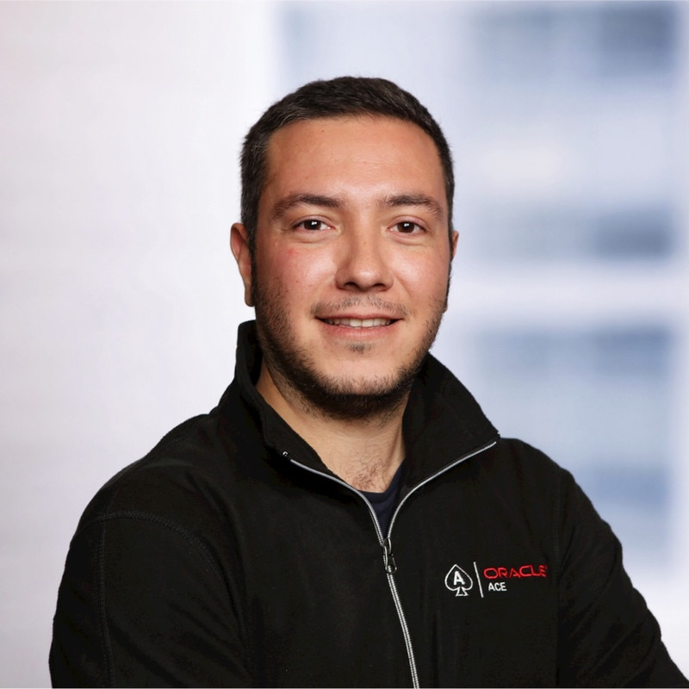



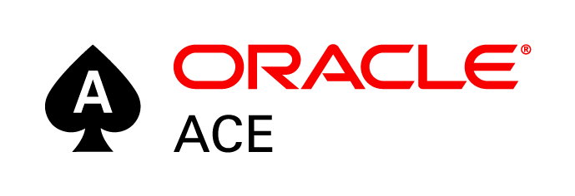
Jürgen Kress
(Oracle)
Rubén Rodríguez
Rolando Carrasco
Lucas Jellema

Slide 18
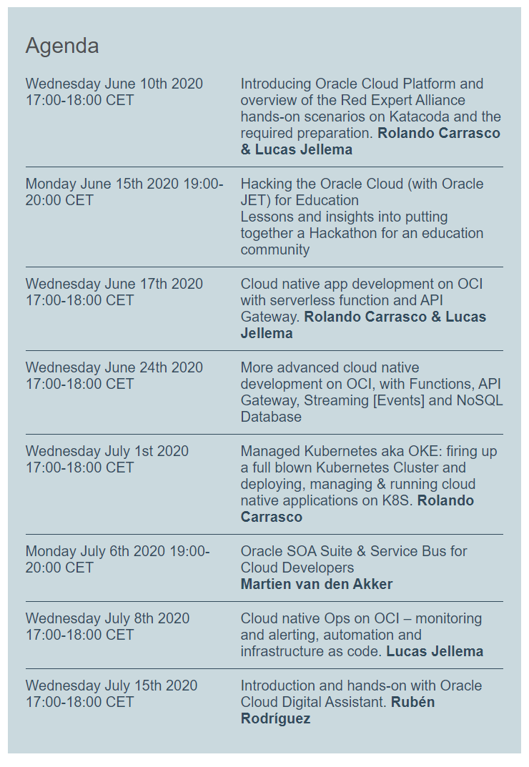

Six Super Wednesdays
Oracle Developer Virtual Meetups
Kick Off Wednesday June 10th 2020: TODAY
5 - 6PM CET / 3 – 4PM UTC
All sessions are recorded and will be available for replay
Guided handson Katacoda scenarios:
http://bit.ly/real-oci

Slide 19
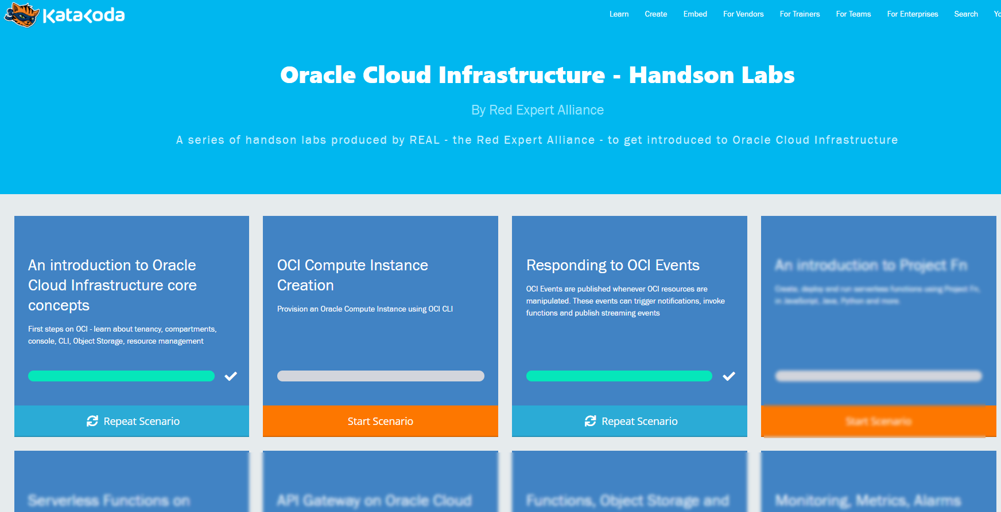
Six Super Wednesdays
Introduction of Oracle Cloud Infrastructure (Oracle Cloud Gen2)
Console | CLI | Cloud Shell & OCI Object Storage (Scenario 1)
Preparation for the Katacoda Hands-On Labs
OCI Compute (Scenario 2)
OCI Events & Notifications (Scenario 3)
Q&A
Live Hands-On (TOY: Try Out Yourself)

Slide 20
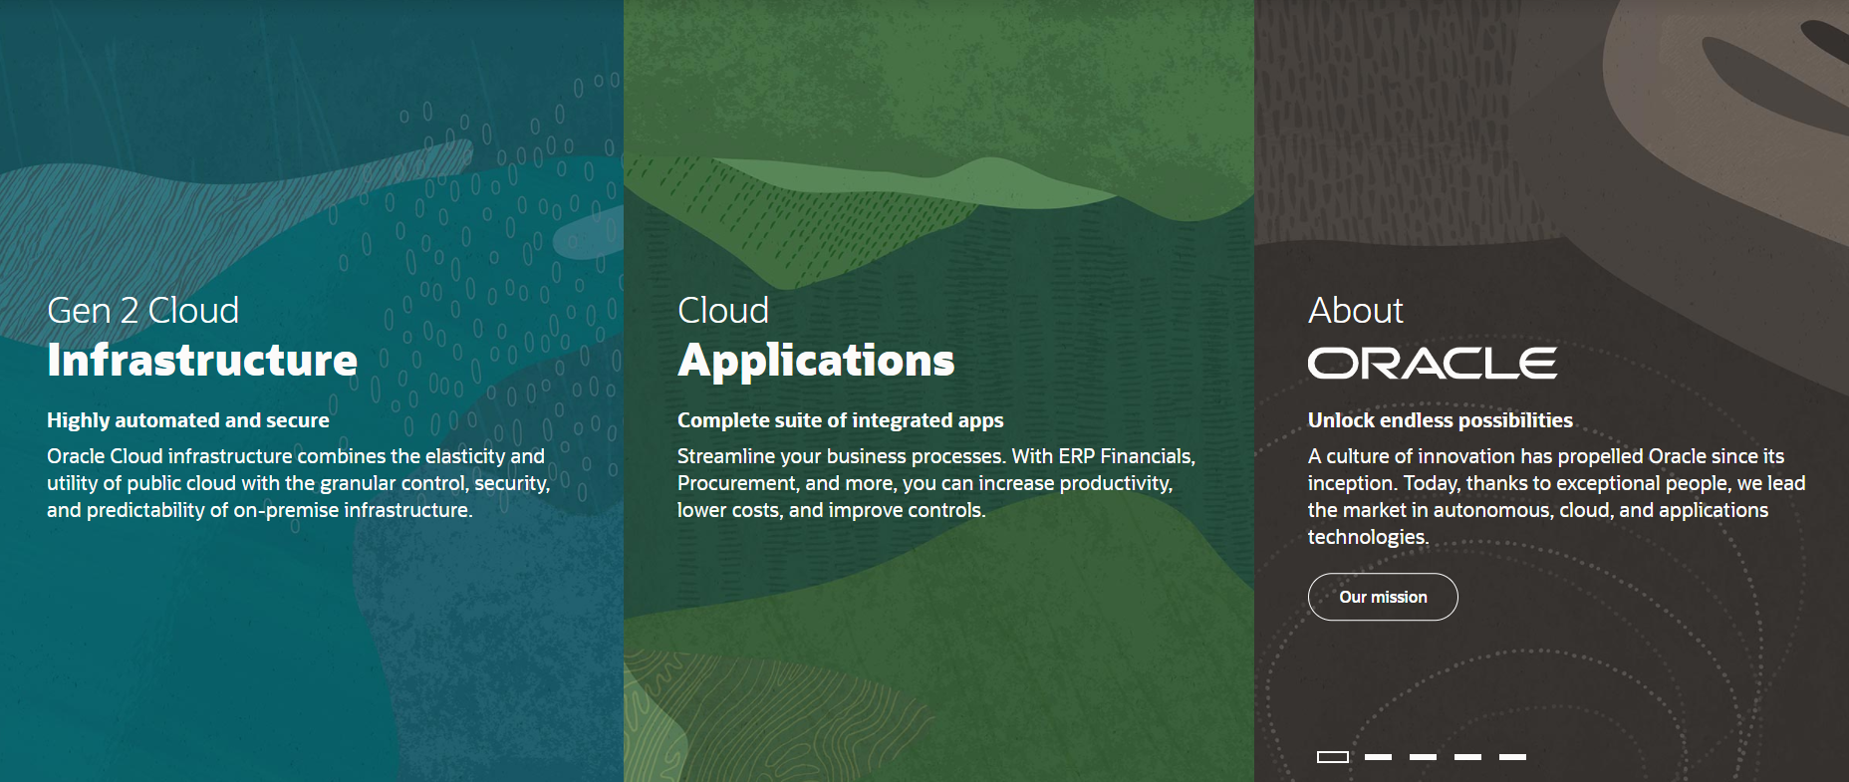

Slide 21

Oracle Cloud Gen2
First generation is now called Classic Cloud
Mainly On Premises software, running in Oracle’s data centers – with some (small) degree of operational management (mainly provisioning and patching)
Not Cloud Native
Gen2
(largely) Designed from the ground up for the cloud
Applying lessons learned – from classic cloud as well as AWS and Azure
Some focused acquisitions (Dyn, Corente, Palerra, Wercker, DataScience.com)

Slide 22

Oracle Cloud Infrastructure
Generation 2 Cloud
Main themes:
Competitive Pricing
Secure by Design
Open
Enterprise (Technology)
Trials – 30 days, $300 credits
An always-free tier
With Autonomous Database and Autonomous Data Warehouse

Slide 23
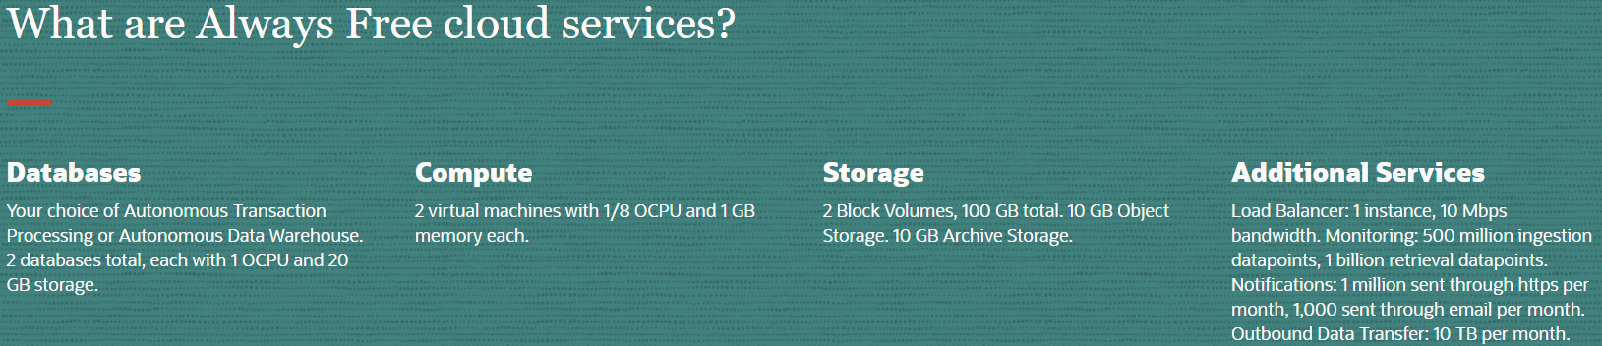
Oracle Cloud Infrastructure – Always Free Tier
Always Free Tier
Autonomous Database/Data Warehouse (two instances)
Compute VMs (two instances)
Block, Object and Archive Storage
Load Balancer and Data Egress
Monitoring and Notifications

Slide 24
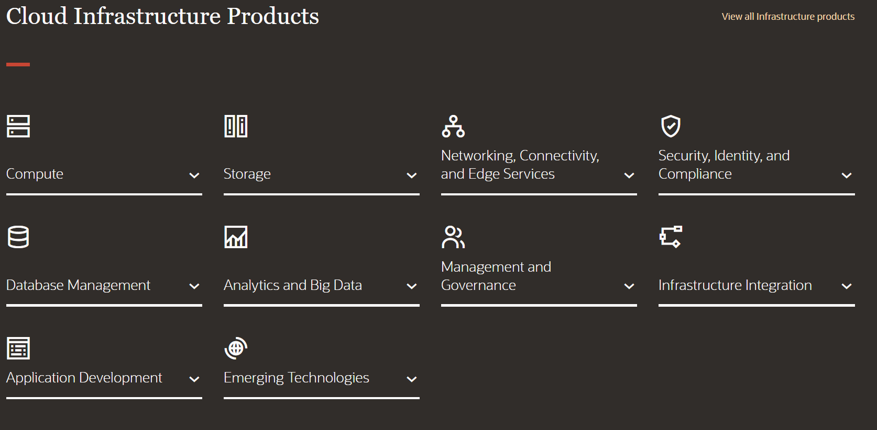
Introducing Oracle Cloud Infrastructure

Slide 25
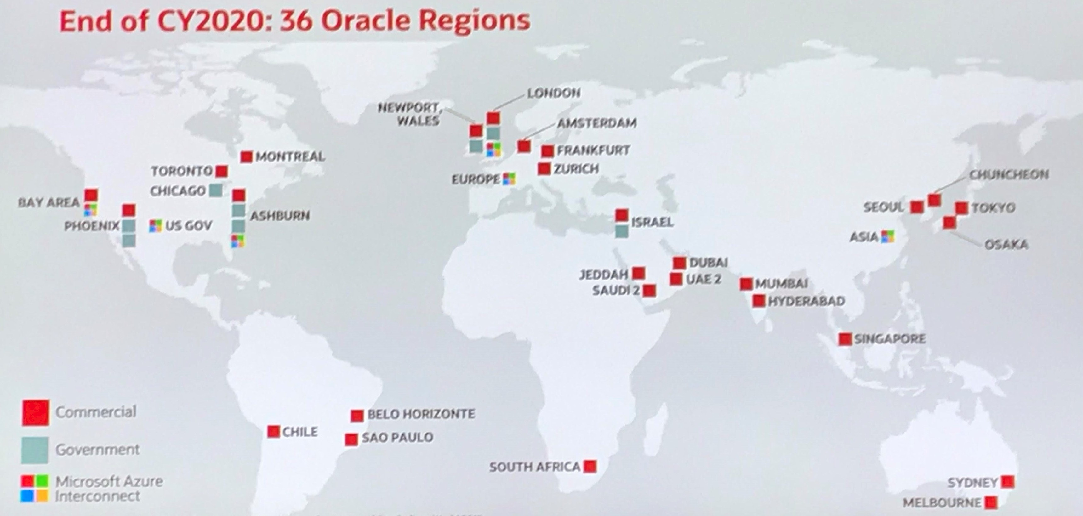
Introducing Oracle Cloud Infrastructure

Slide 26
OCI Physical Organization
Regions have one or more Availability Domains
An AD lives in one or more Data Centers
ADs are isolated from each other – unlikely to fail together
ADs within a region have very fast, ultra-low latency interconnecting network backbone
Fault domains are isolated hardware clusters
With exclusive patch schedule
Each AD has three fault domains
Fault Domain
Data Center
Availability Domain
Region

Slide 27
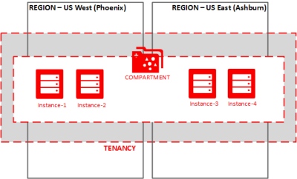
Logical Organization
OCI resources live in Compartments
Compartments are logical units – used for organizing, naming, managing and authorization
Compartments can be nested
The Tenancy itself == the Root Compartment
Compartments can span across physical units such as ADs and regions
Virtual Machine
Compartment
Compartment
Tenancy
(== Root Compartment)

Slide 28
Tools
OCI Console – browser based GUI
OCI CLI
OCI SDKs – Java, Python, Ruby, Go, TypeScript
OCI REST APIs
Tools & Plugins
Ansible Modules
Terraform Provider
Chef Knife Plugin
Oracle Developer Tools for Visual Studio Code
Toolkit for Eclipse
HDFS Connector
OCI Cloud Tenancy

Slide 29
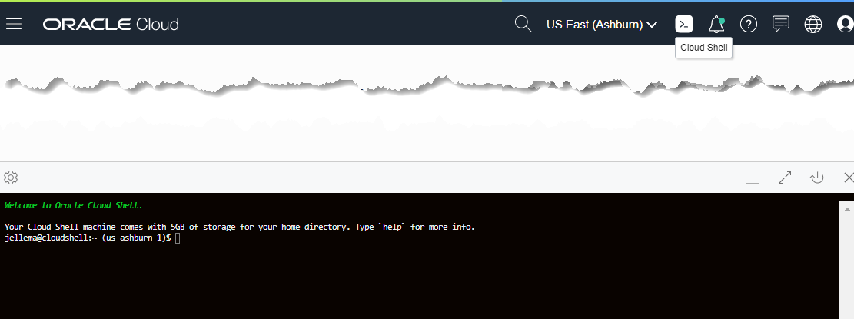
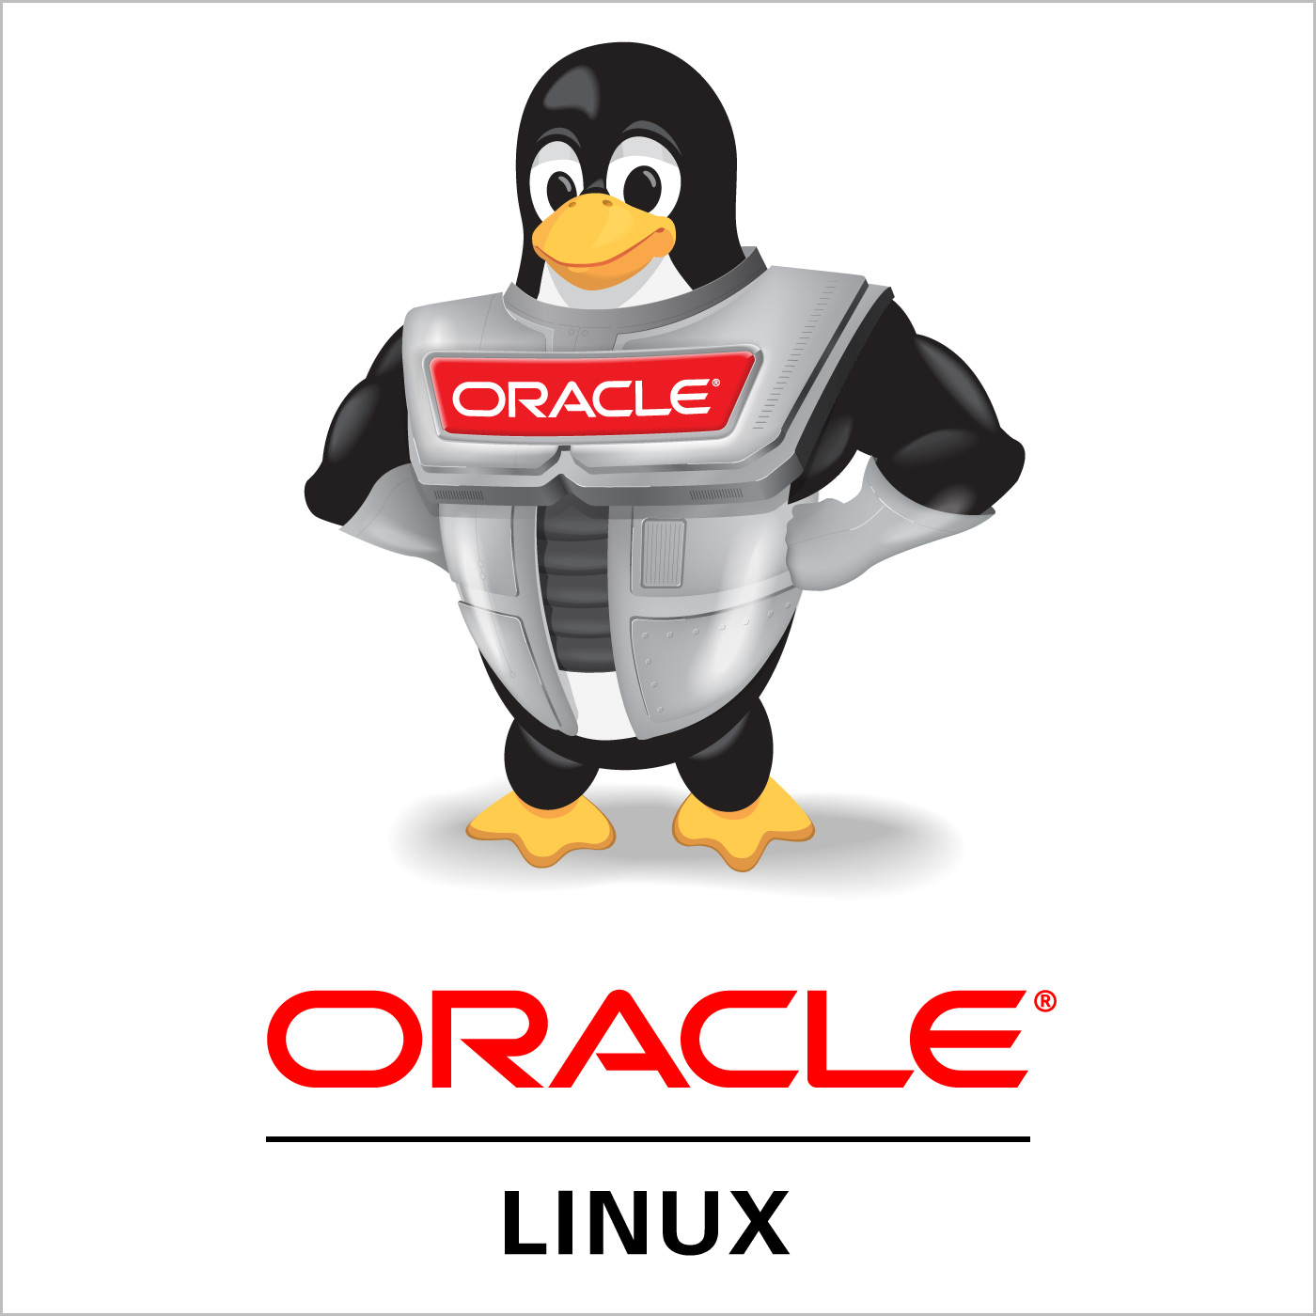
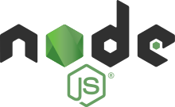
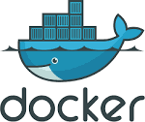
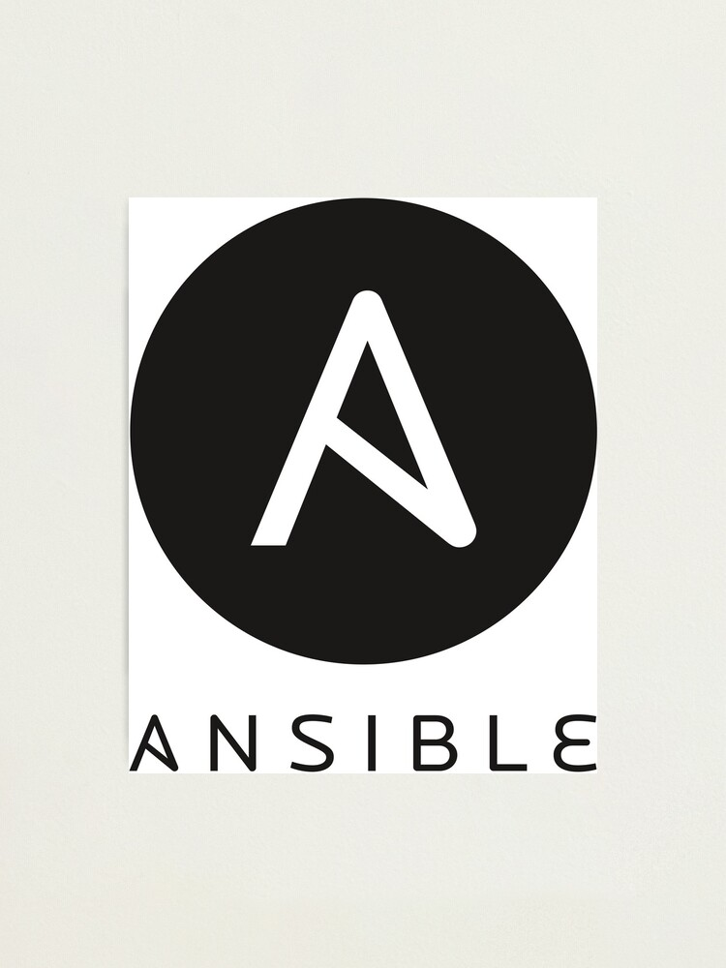



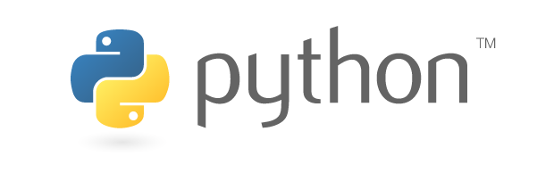
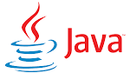

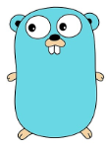
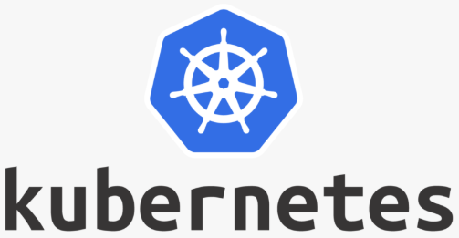

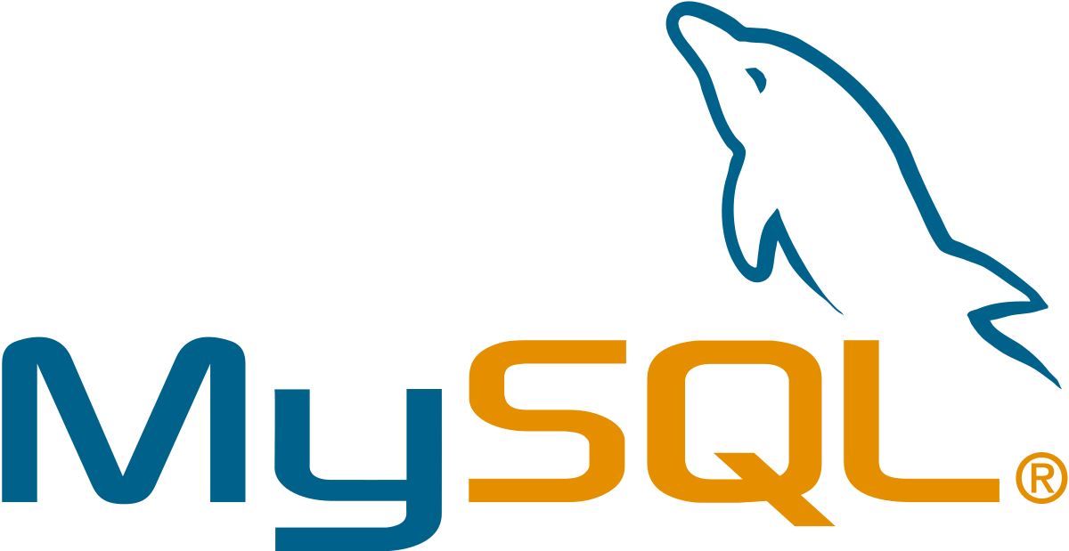





Cloud Shell
OCI Cloud Tenancy

Slide 30
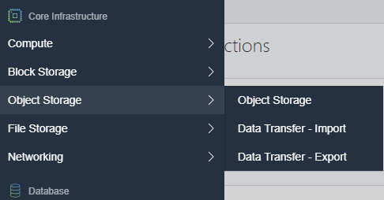
Object Storage
“an internet-scale, high-performance storage platform that offers reliable and cost-efficient data durability. The Object Storage service can store an unlimited amount of unstructured data of any content type, including analytic data and rich content, like images and videos.”
Note: use Archive Storage for data which you rarely access, but that must be retained and preserved for long periods of time.
The cost efficiency of the Archive Storage tier offsets the longer lead time required to access the data.

Slide 31
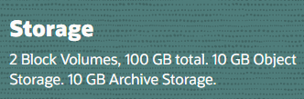
Object Storage
A regional service – not tied to a compute instance or even an AD
Organized in Namespaces, Buckets (similar to Folders) and Objects
Max Object Size is 10TiB (in parts of max 50 GiB)
one tebibyte (1 TiB) is approximately equal to 1.1 TB
Object Storage is Always Free eligible
Object Storage provides
Durability – multiple copies, automatically maintained
Encryption - 256-bit Advanced Encryption Standard (AES-256)
S3 Compatible REST API
HDFS Connector (to act as backend for Spark and Hadoop MapReduce)
Pre-authorized requests for time-limited, direct access
Life Cycle Rules

Slide 32
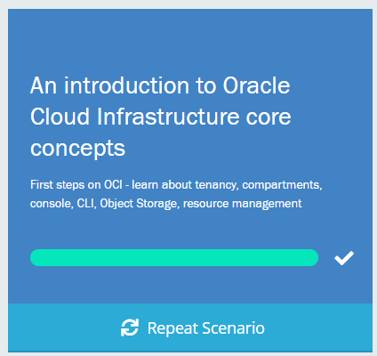
First Handson Scenario: Introducing OCI
Learn about Compartments, OCID, Tags, Search, Audit
Use the tools Console, Cloud Shell, OCI CLI
Get started with the Object Storage Service
http://bit.ly/real-oci

Slide 33
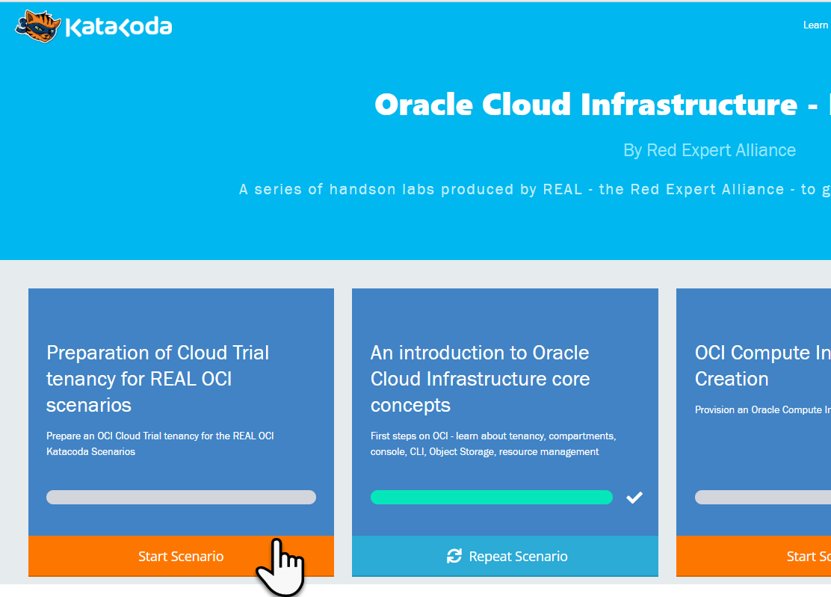
Preparation for the Katacoda Hands-On Labs
Arrange access to Oracle Cloud Infrastructure Tenancy
Existing or new OCI Cloud Trial
Existing OCI tenancy
Go to http://bit.ly/real-oci home of the REAL Katacoda scenarios for OCI
Run First Scenario to prepare the OCI tenancy for REAL Katacoda OCI Scenarios
Provision an OCI compartment and some resources
Prepare auth token, key pair and config file for using the OCI CLI in other scenarios
Go http://bit.ly/real-oci

Slide 34
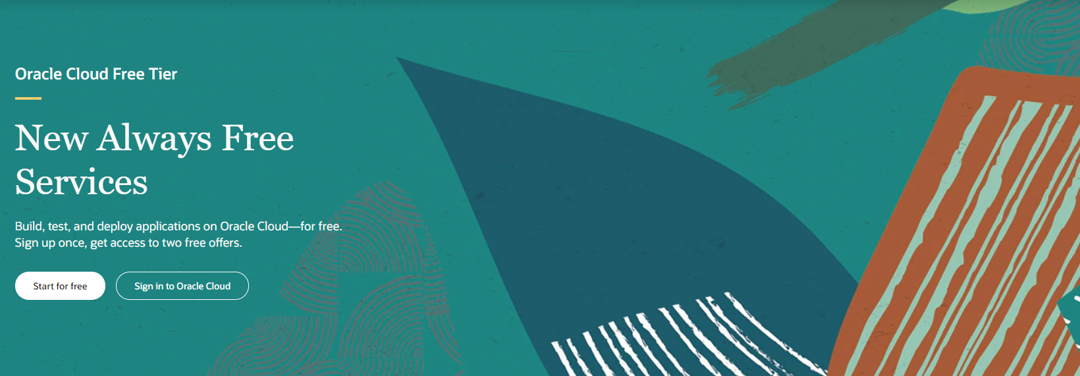
Cloud Trial as Registered Webinar Attendee
cloud.oracle.com/tryit
Signup for Cloud Trial with same email address as used for webinar registration
Use a company email address (not gmail or hotmail); do not use an address already used for an Oracle Cloud Trial
Do not use credit card – because email is whitelisted (as of tomorrow, June 11th)
You will get
$500 credits on (discounted) Oacle cloud services
Access to always Free Tier

Slide 35

Steps in Tenancy Preparation Scenario
OCI Trial Tenancy
Generate Key Pair & Upload Public Key to OCI
Fetch details for Config file
OCI Browser Console
Cloud Shell
2
3
Copy & Paste Private Key (oci-api-key.pem)
Copy & Paste config file details
Copy & Paste Private Key (oci-api-key.pem)
Copy & Paste config file details
OCI CLI
1
4
Laptop
OCI CLI configuration:
.oci/oci-api-key.pem and .oci/config
OCI CLI configuration:
.oci/oci-api-key.pem and .oci/config
3
4

Slide 36
Steps in Tenancy Preparation Scenario
6
Security
Group
VCN
vcn-lab
Tag Namespace
lab-tags
IGW
Public Subnet-vcn-lab
Private Subnet-vcn-lab
policies
API Gateway
lab-apigw
Dynamic Group
lab-apigw-dynamic-group
Stream
lab-stream
OCI Browser Console
Compartment – lab-compartment
Create OCI resources and define policies
5
OCI CLI
Laptop
OCI CLI configuration:
.oci/oci-api-key.pem and .oci/config

Slide 37
The Prepared Tenancy
Security
Group
VCN
vcn-lab
Tag Namespace
lab-tags
IGW
Public Subnet-vcn-lab
Private Subnet-vcn-lab
policies
API Gateway
lab-apigw
Dynamic Group
lab-apigw-dynamic-group
Stream
lab-stream
Compartment – lab-compartment

Slide 38
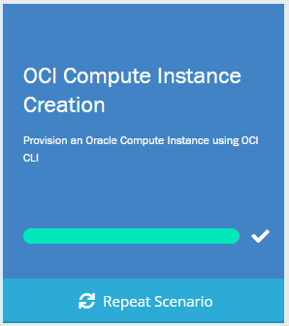
COMPUTE INSTANCES
http://bit.ly/real-oci

Slide 39
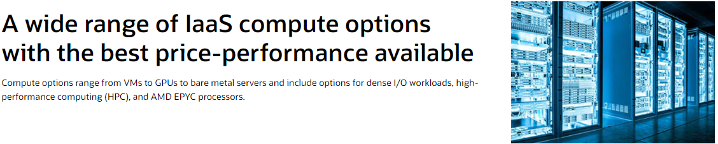
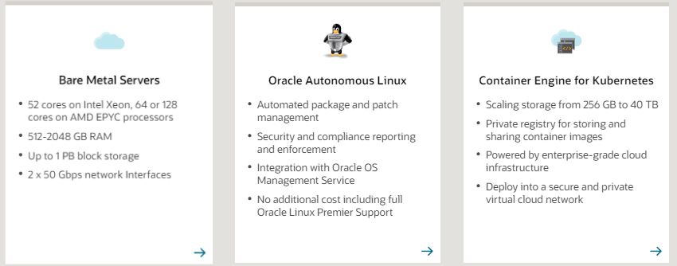
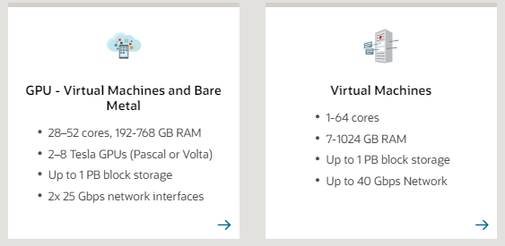
Compute Instances

Slide 40

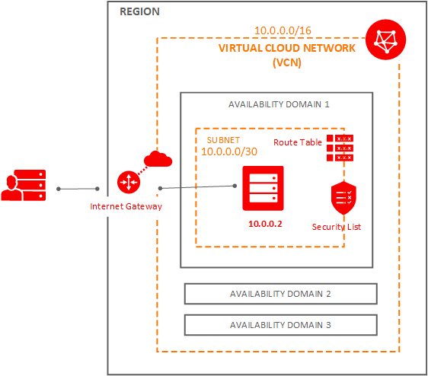
Compute Instances in a nutshell
Several alternatives for compute instances.
They vary among shapes, public (visible from internet), private, operating systems, image, etc
You can create compute instances using images provided by Oracle; you can create your own images; you can create an image using a boot volume
You can scale out your instances, using rules. Those rules are related with memory and cpu usage of your instances
You can backup your instances
https://www.oracle.com/cloud/compute/

Slide 41
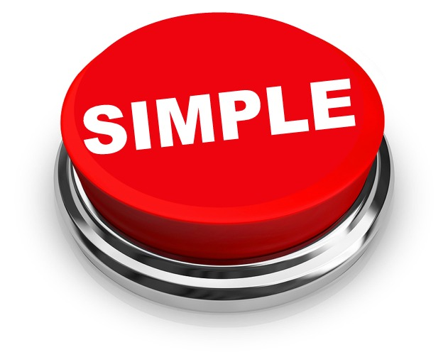
Compute Instances
Simple.
You have multiple alternatives that are there to fit the needs for your applications.
Use them!

Slide 42


Why and What a Katacoda Scenario for Compute Instance?
Compute instances are common place in OCI
OCI CLI is very powerful. Just one CLI command and the instance will be created and running
You can install products during the provisioning process
It helps us to understand elements learned in the Lab Preparation Scenario, such as: VCN, SUBNETs, etc
Compute Instance with VM.Standard2 shape
Compute Instance with NGINX

Slide 43
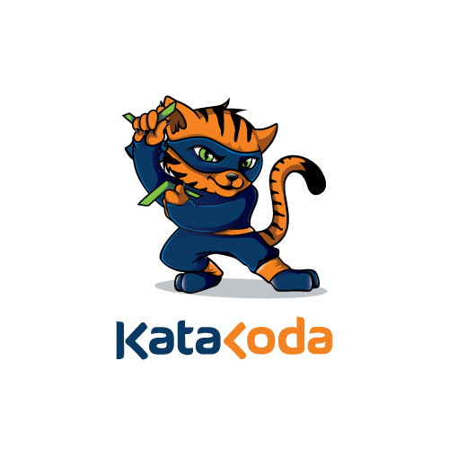
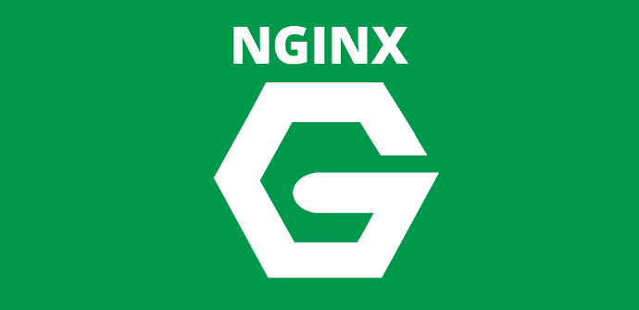
COMPUTE INSTANCE KATACODA SCENARIO
We have one scenario where you will learn how to provision a compute instance
We will do it using Oracle CLI
http://bit.ly/real-oci
1
DEFINE THE SHAPE
2
DEFINE REGION, VCN, SUBNET
3
DEFINE IF IT IS PUBLIC OR PRIVATE?
4
RUN THE CLI
5
COMPUTE PROVISIONED WITH NGINX

Slide 44
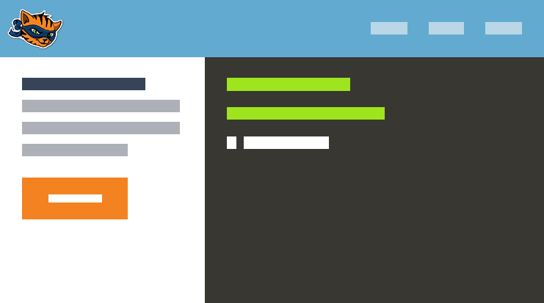
This is what you will get:

Slide 45
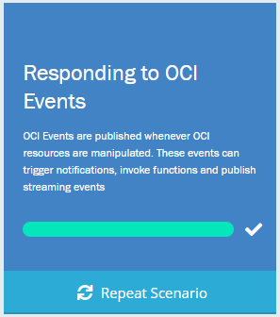
EVENTS SERVICE.
NOTIFICATION SERVICE
http://bit.ly/real-oci

Slide 46
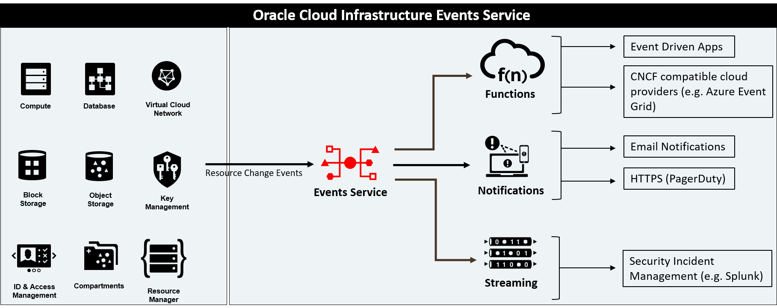
EVENTS and NOTIFICATIONS SERVICES

Slide 47
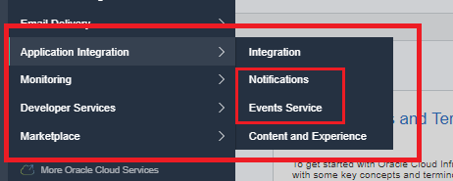
EVENTS. NOTIFICATIONS
The Events and Notifications are OCI Services that were released last year (2019), and that are used to configure rules, notifications and events that happen within the OCI infrastructure
For example: every time a user creates a Bucket within the Object Storage, you (as an operator) may be interested to get an email or run a function. Well that is exactly the purpose of this
The basics of this are:
Notifications
Subscriptions
Topics
Rules
Events

Slide 48
THE BASICS FOR THESE TWO SERVICES ARE…
EVENTS SERVICES
NOTIFICATION SERVICES
Event
Bucket
Cloud Event
Event
Email
Event Rules
Notifications
Event
Notification
Topic
Functions
Event
Streaming

Slide 49
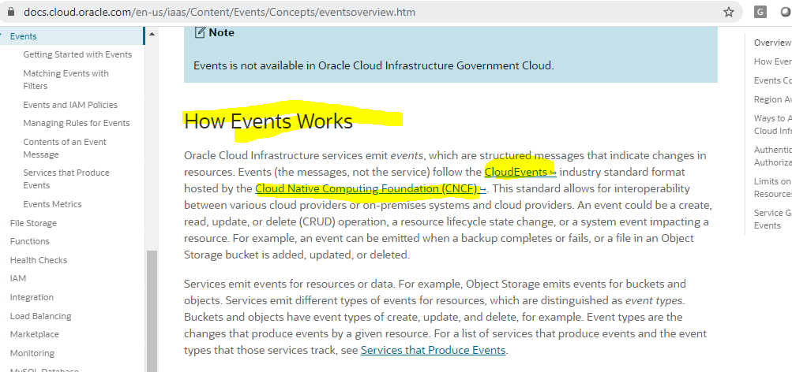
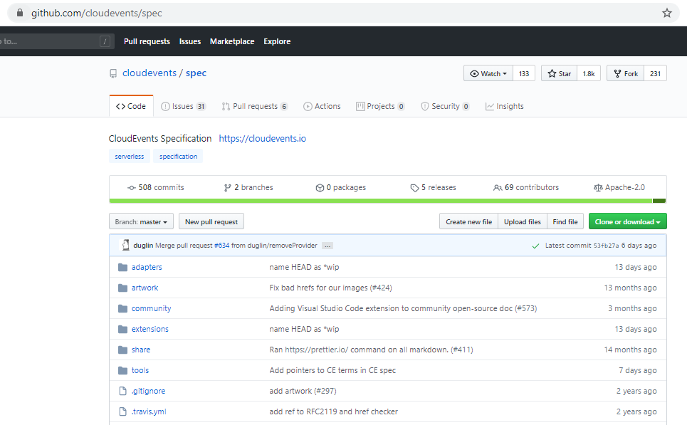
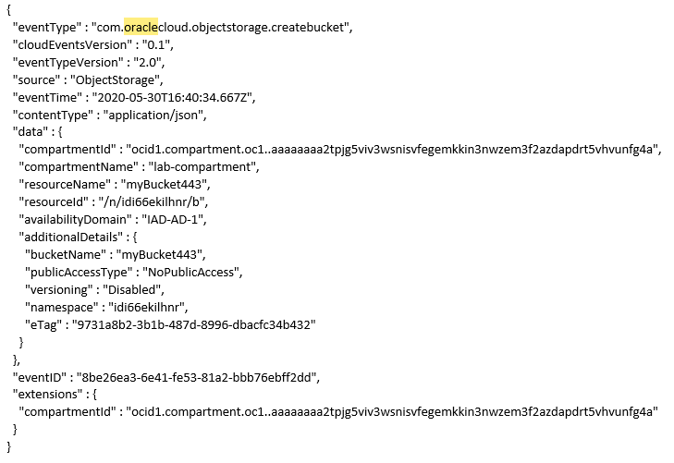

CNCF Based
Event

Slide 50
Why and What a Katacoda Scenario for Events Service?
Because it is useful for operators to know that they can react on resources creation or changes
You can mix more OCI components, for example: resources, functions, etc
It is a relatively new OCI Service. You can explore it and start using it
Because with this you can practice OCI CLI
Create Topic and a Subscription
Create a rule that works with the Bucket Create Event.
Create an action to send notifications through the Topic you’ve created, everytime a bucket is created.

Slide 51

Katacoda scenario

Slide 52
EVENT SCENARIO IN KATACODA
1
CREATE A TOPIC AND SUBSCRIPTION
2
CREATE A RULE BASED ON A BUCKET CREATION
3
THE ACTION WILL TRIGGER A NOTIFICATION AND USED BY A TOPIC
4
THE EMAIL WILL BE SENT TO THE MAILBOX THAT WE USED IN THE SUBSCRIPTION (TOPIC)
5
REVIEW THE EVENT FORMAT
http://bit.ly/real-oci

Slide 53

Q&A and Live Handson
Ask your questions in the Q&A Window
Cloud Trial:
We will stay online for the next hour to help you out with handson challenges
cloud.oracle.com/tryit
http://bit.ly/real-oci

